Slide 1
Concierge-
CONC Academy
Menu
Competitor Screenshots
Additional Information
Research: Injector certification programs

Slide 2
Menu
Home
About
Courses
Botox
Dermal Filler
Model Sign Up
Enrollment
Location & Dates
Pricing & Financing
Contact
Pop-Up Options: Request Brochure, $50 off first class

Slide 3
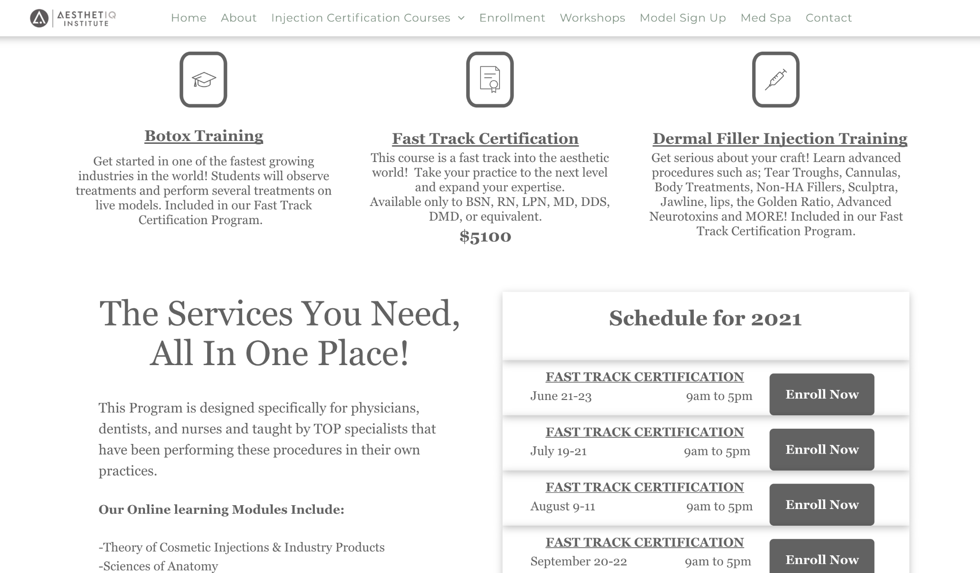

Aesthetic Institute: https://www.aesthetiqinstitute.com/injection-certification-courses

Slide 4
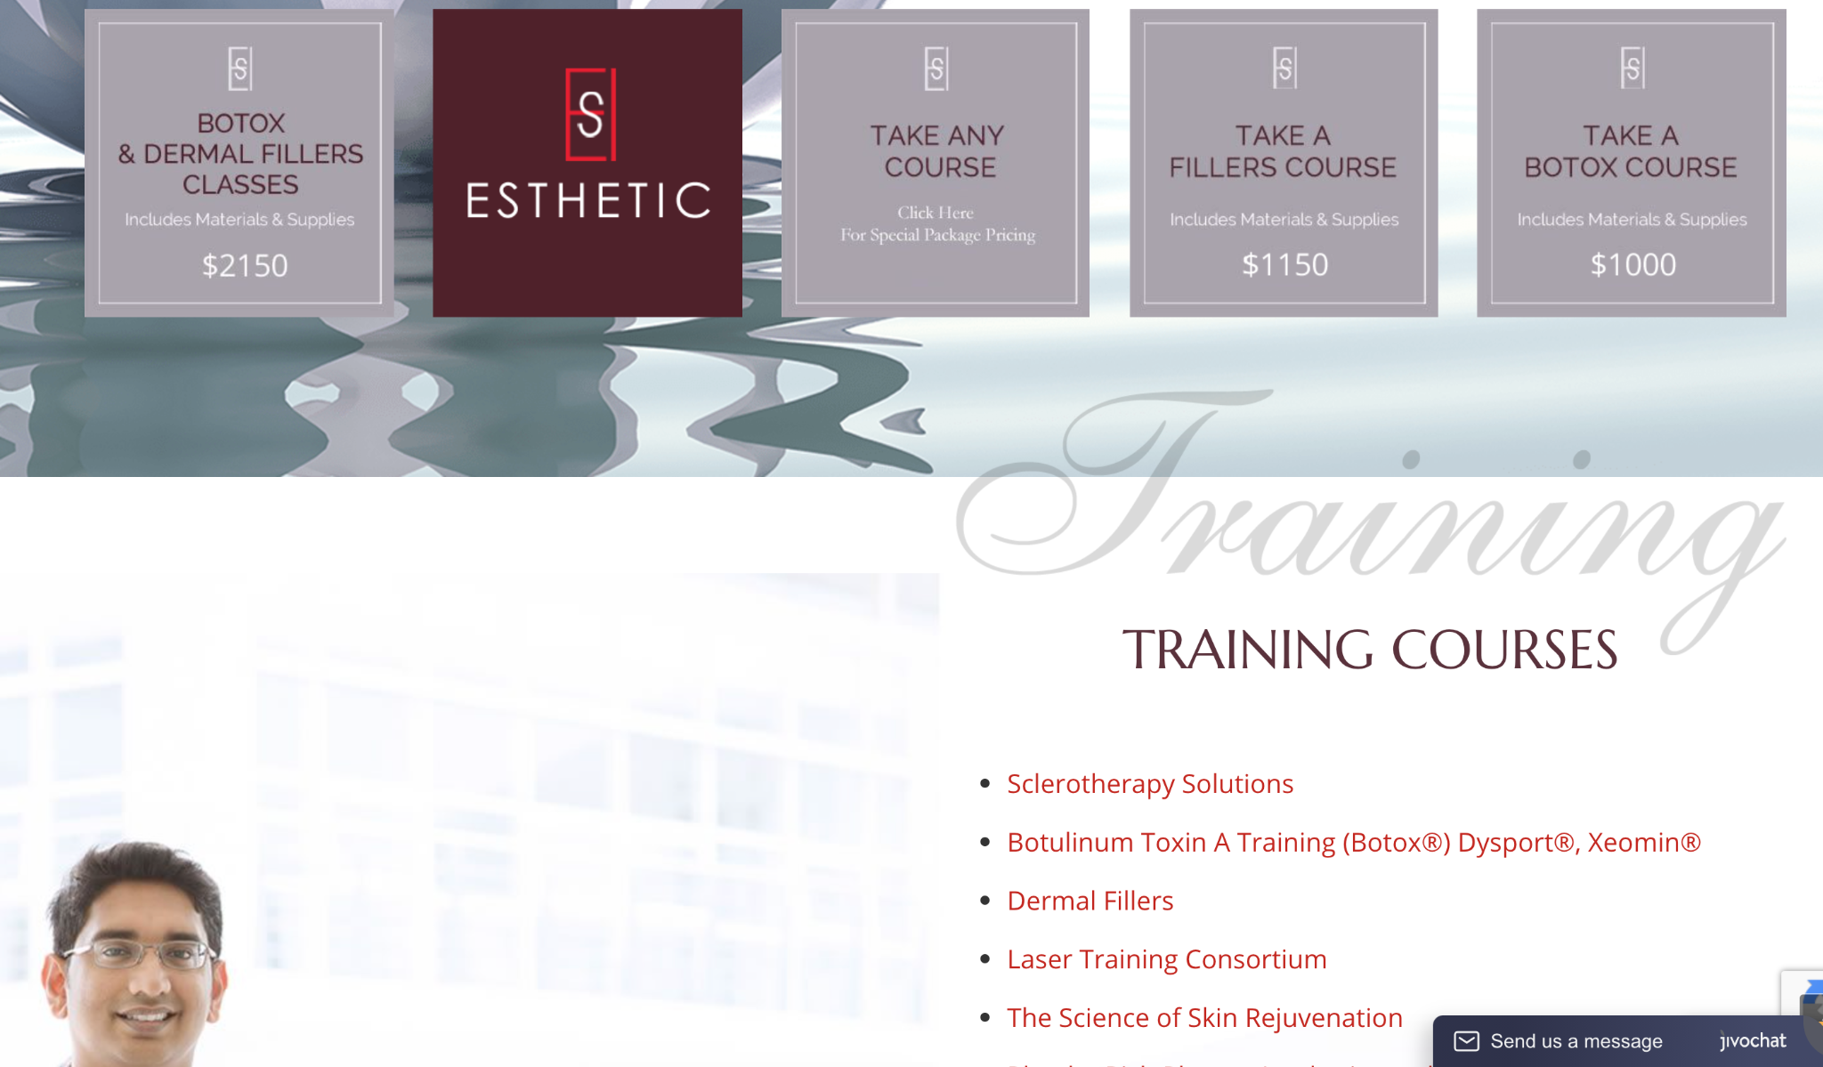

Esthetic Skin Institute:
https://www.esiw.com/

Slide 5
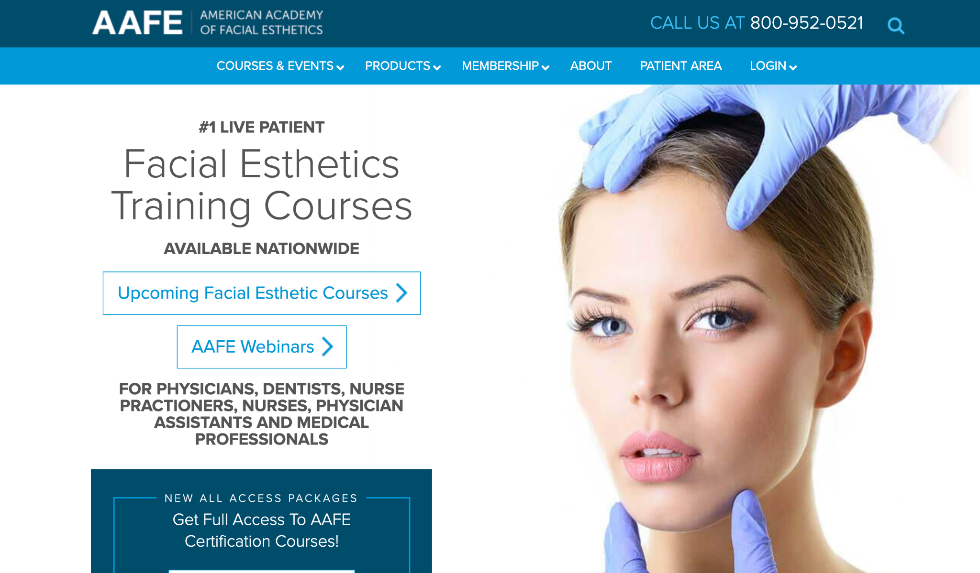
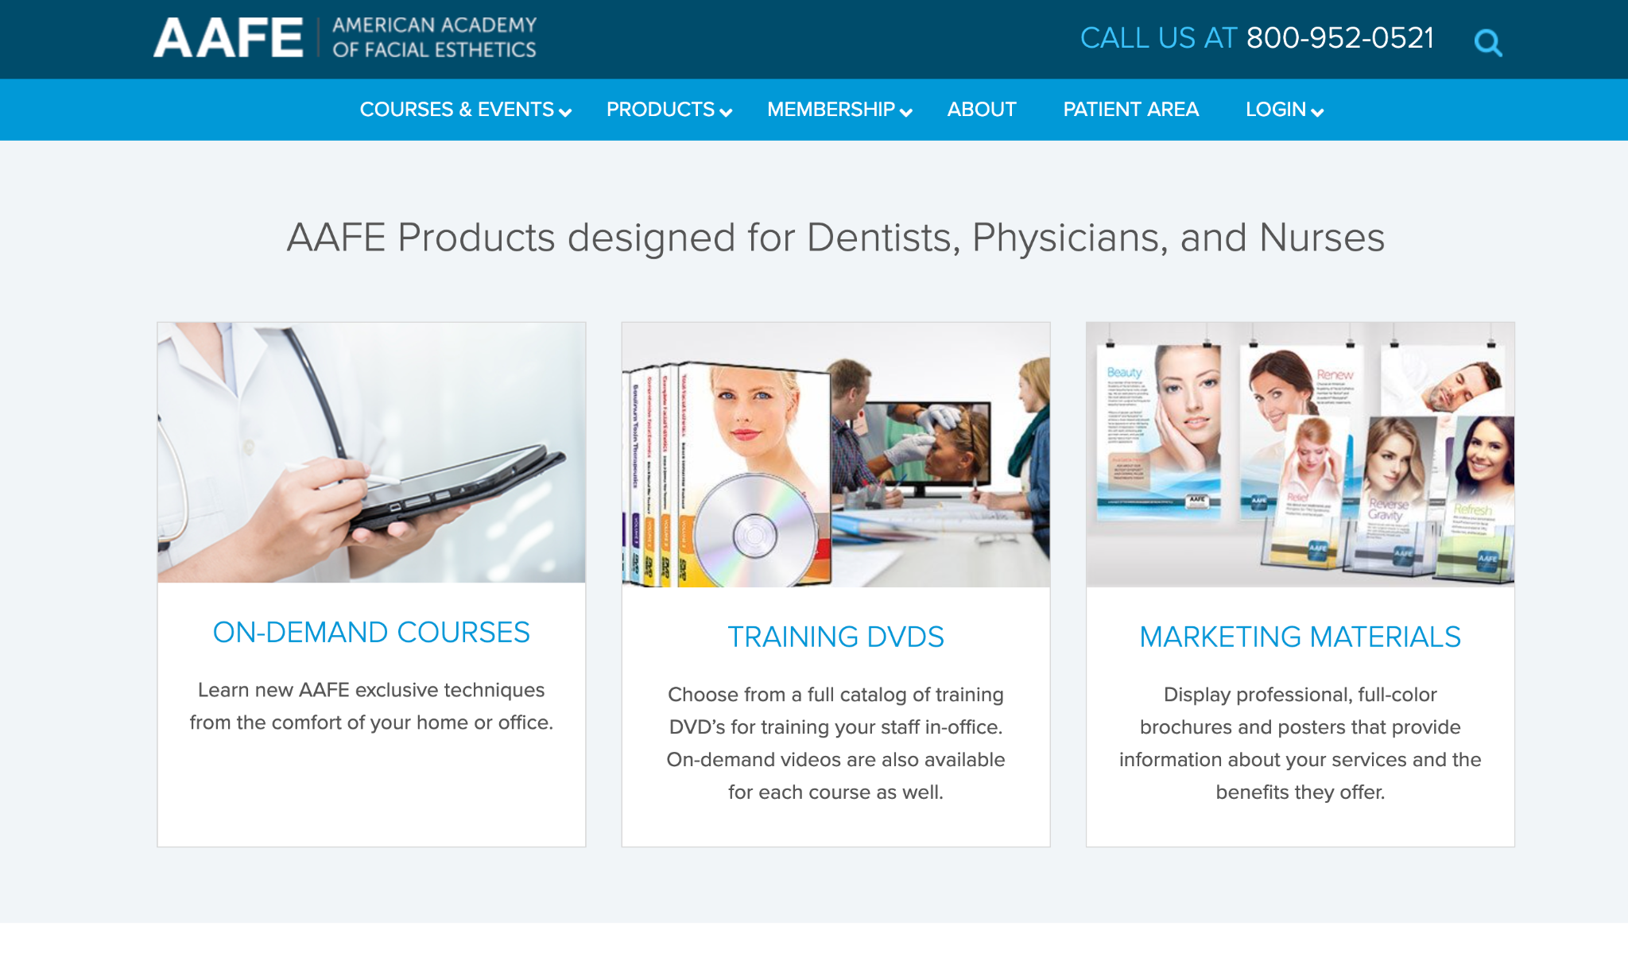
American Academy of Facial Esthetics AAFE:
https://www.facialesthetics.org/

Slide 6
Items needed:
Logo
Cancellation policy
Online forms
Continuing Education information
Pricing
Financing options
Instructor bios & photos
Calendar of dates available
Course outlines
Contact information
Merchant/booking info for scheduling and paying online

