Slide 1
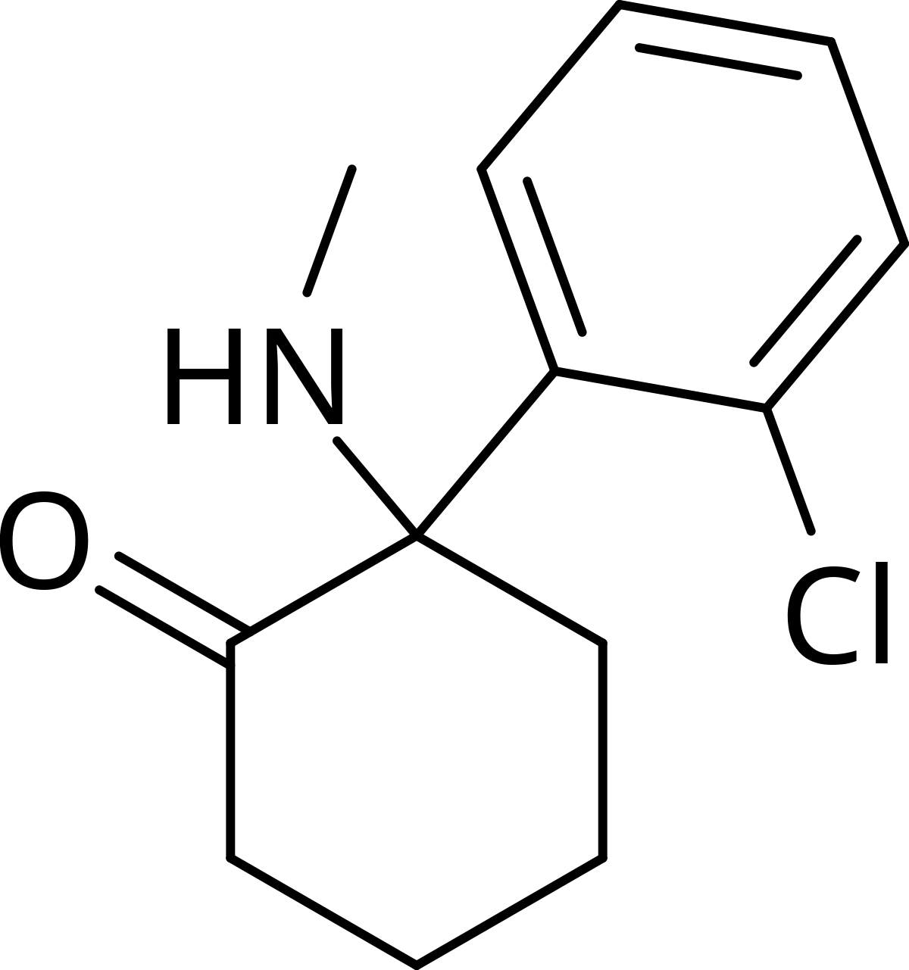
Research: Ketamine Clinic Websites
Client: K Therapy SLC
Website: www.theoryandmethod.co
October, 2020

Slide 2
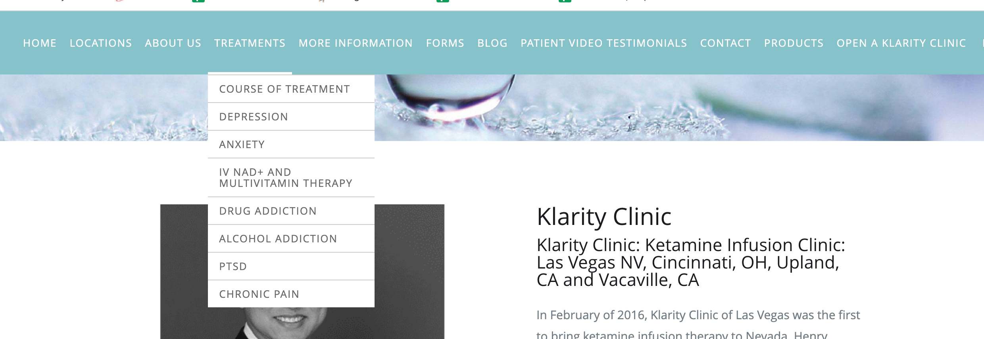
Klarity Clinic: Locations in Las Vegas | OH | CA
Menu Options We Should Borrow from this example :
Home
Treatments
[Drop down menu of issues it treats]
-Depression
-Anxiety
-Drug Addiction
-Alcohol Addiction
-PTSD
-Chronic Pain
Forms
Blog
About
https://www.klarityclinic.com/

Slide 3
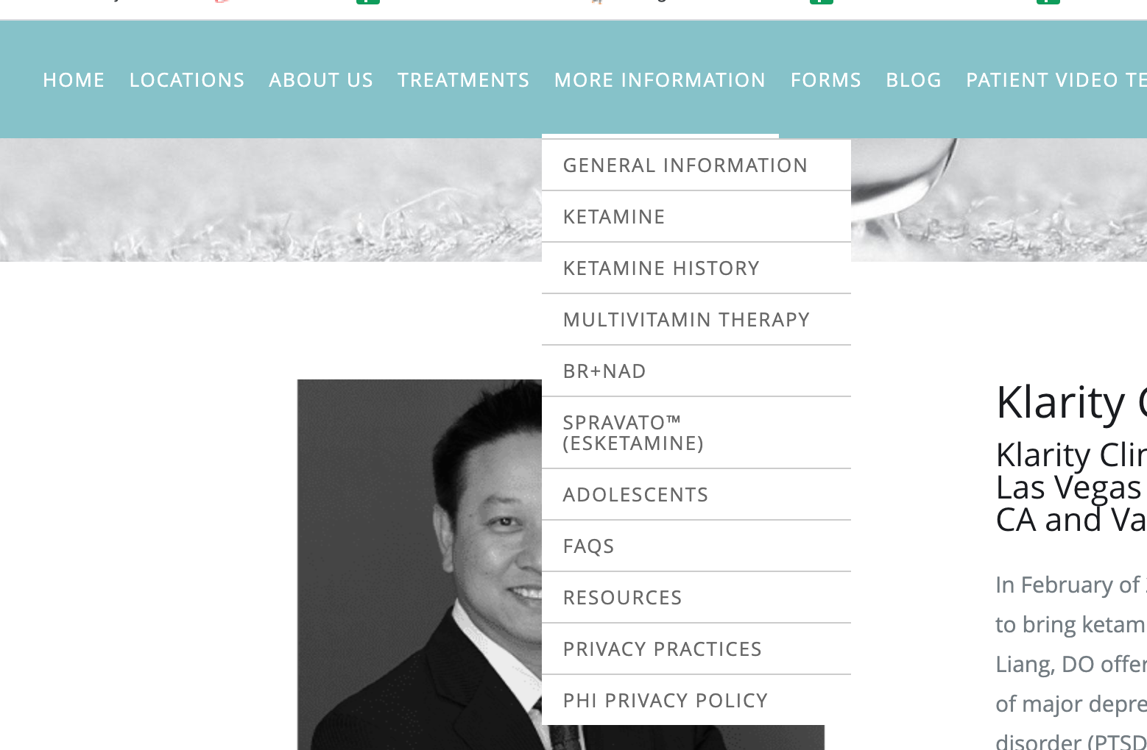
Klarity Clinic: continued… www.klarityclinic.com
I think we should be a “Ketamine History” or “About Ketamine” page. Thoughts?
Not sure what Spravato (Esketamine) specifically is or if Candace offers that but we should ask.

Slide 4
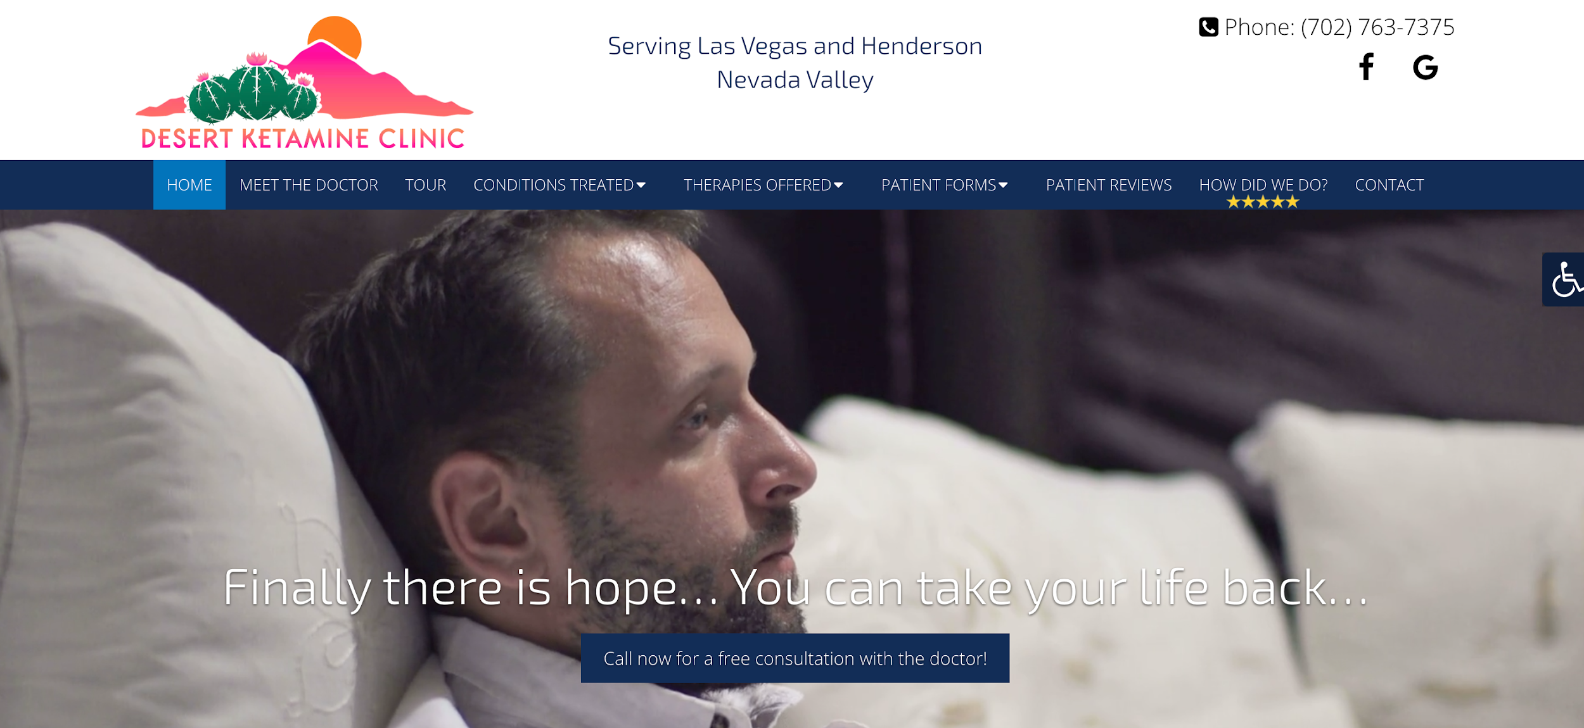
Desert Ketamine Clinic: Location in Las Vegas
Video as hero image seems popular for most of the Ketamine Clinic websites
https://desertketamineclinic.com/

Slide 5
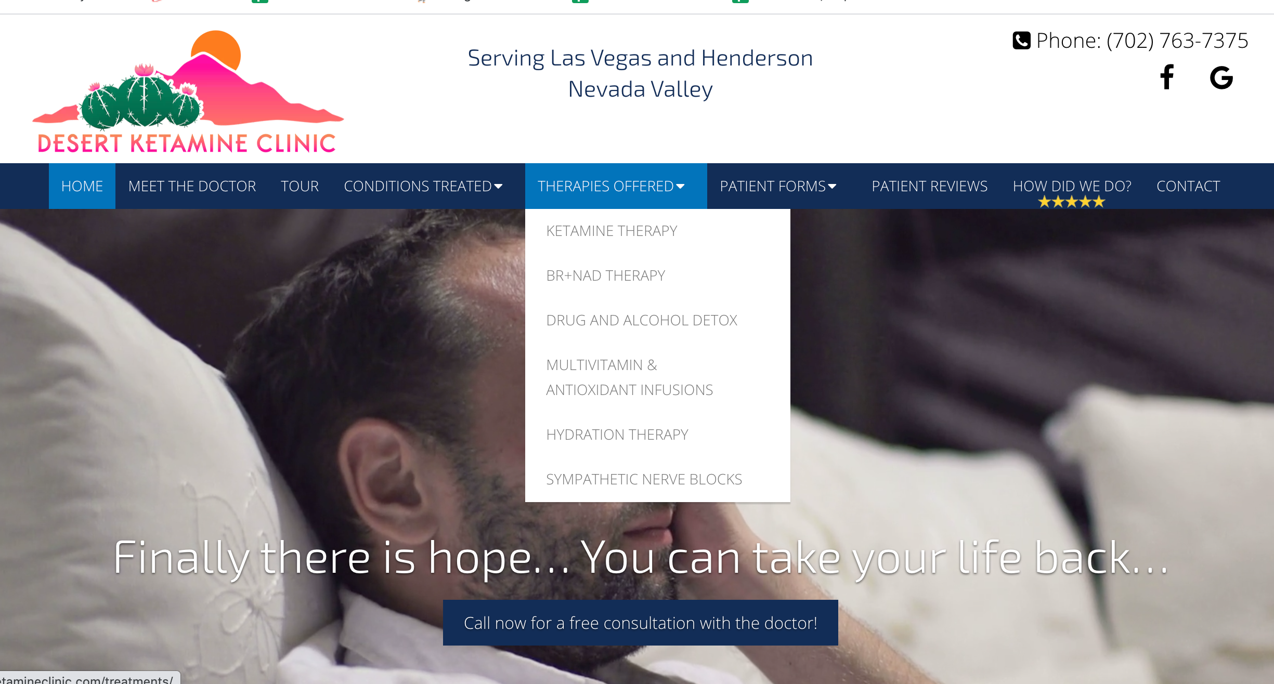
Treatment: Dropdown Options
Lists 5 types of treatments offered instead of just Ketamine and what ketamine can treat like some of the other Ketamine clinics do.
Additional Treatments are
-BR+NAD therapy
-Detox
-Vitamin Infusions
-Hydration IV therapy
-Nerve Blocks

Slide 6
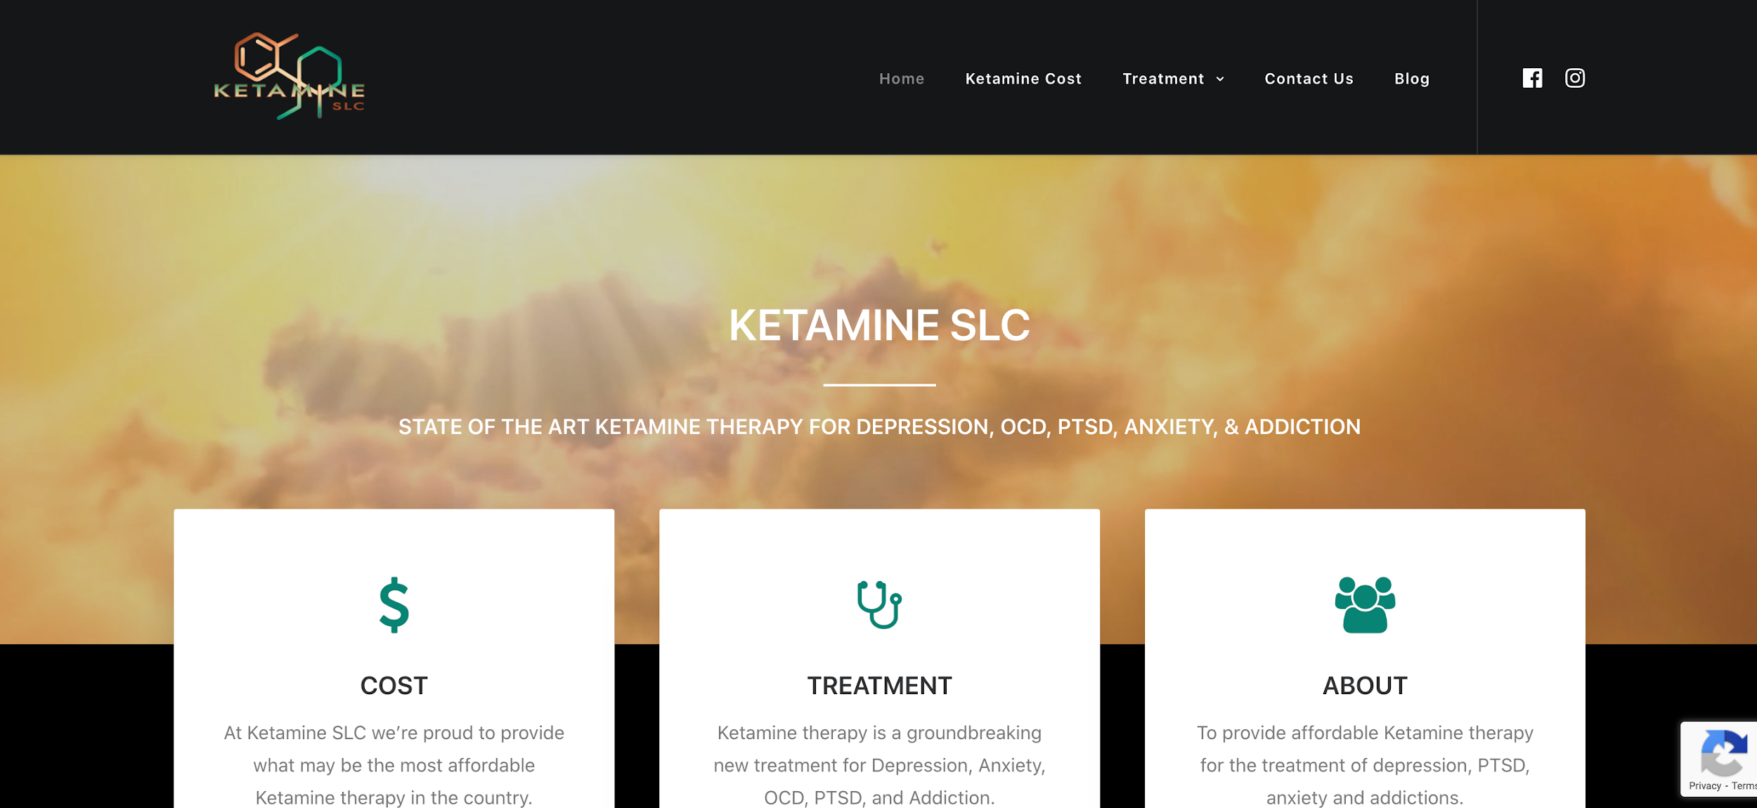
Ketamine SLC: Location in Salt Lake City (main competitor)
Easy to navigate website
Obvious Menu options of Home, Treatment, Contact Us, Blog. Simple
Videos on homepage but not as hero image like some of the others
https://www.ketamineslc.com/

Slide 7
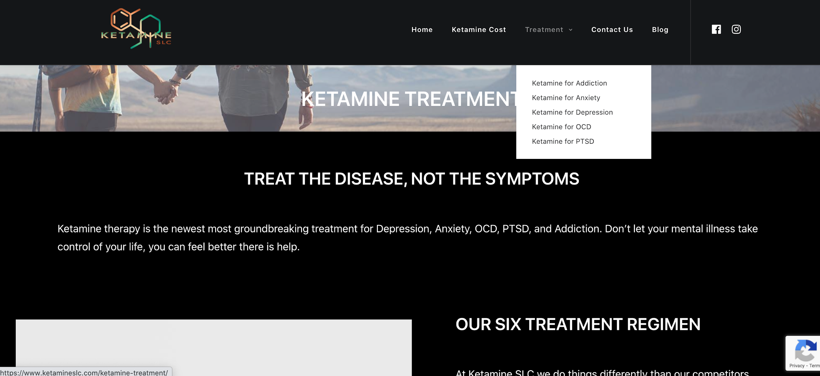
Treatment: Dropdown Options
Treatment Options:
-Addiction
-Anxiety
-Depression
-OCD
-PTSD

Slide 8
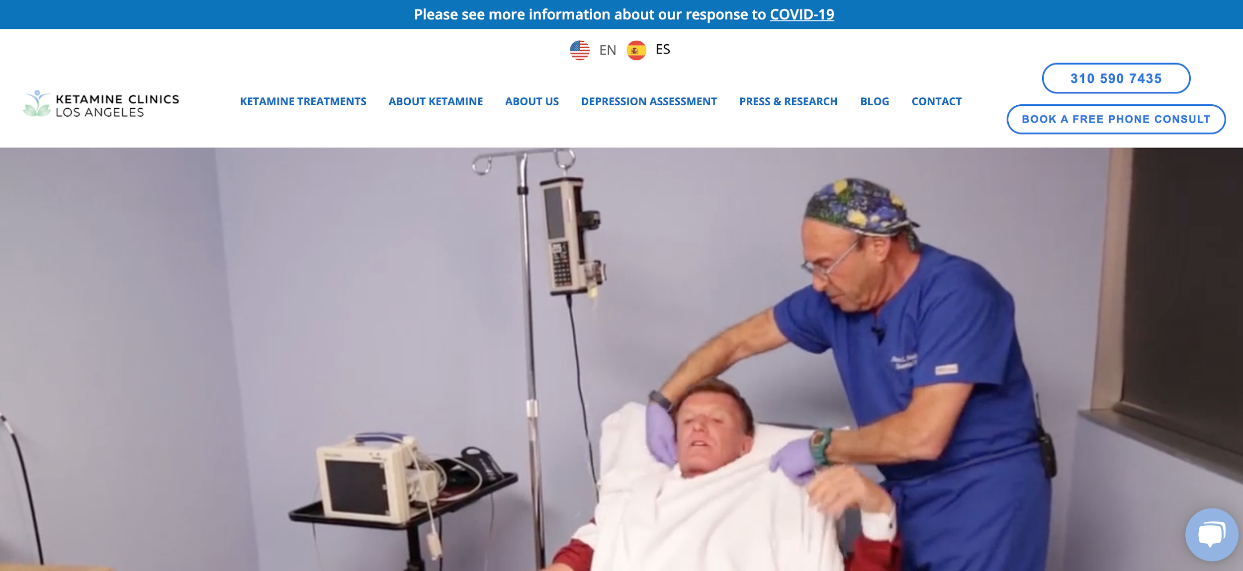
Ketamine Clinics Los Angeles: Location in LA
-Video of procedure as hero image
- Spanish version of website available
https://ketamineclinics.com/

Slide 9
Suggested Structure
(Homepage)
HOME - TREATMENTS - ABOUT KETAMINE - ABOUT US - FORMS - CONTACT US - BLOG
(Treatments)
Need to find out is Candance offers additional IV treatments. If not then, we could do….
Treatments
Depression
Addiction
Anxiety
OCD
PTSD
Chronic Pain
-

