Slide 1
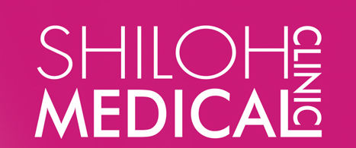
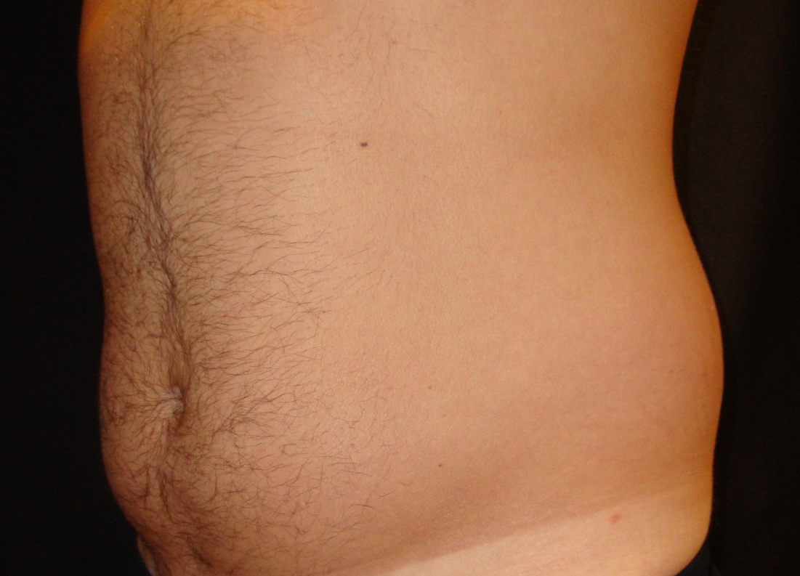
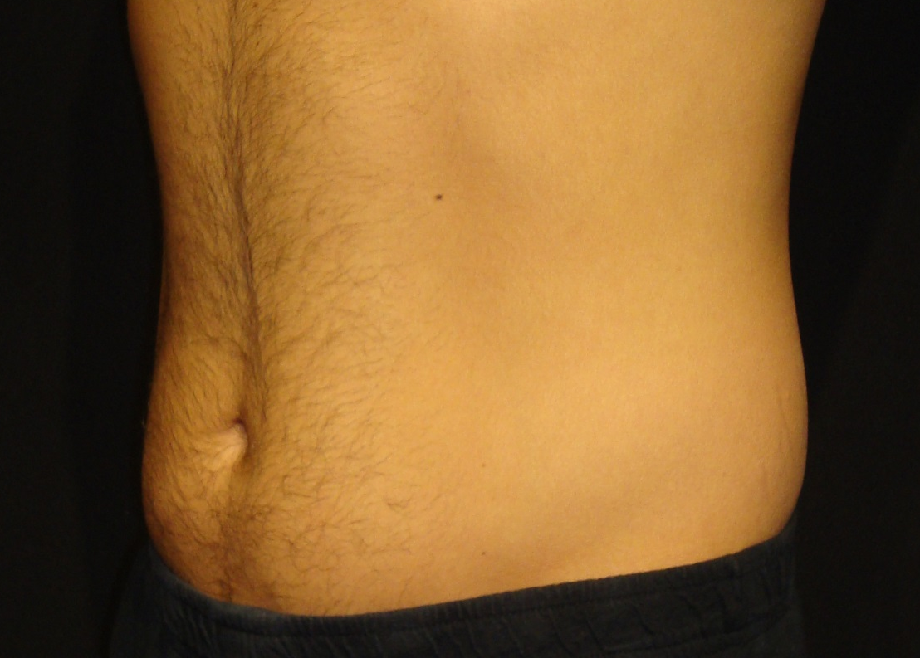
CoolSculpting® Lower Abdomen

Slide 2
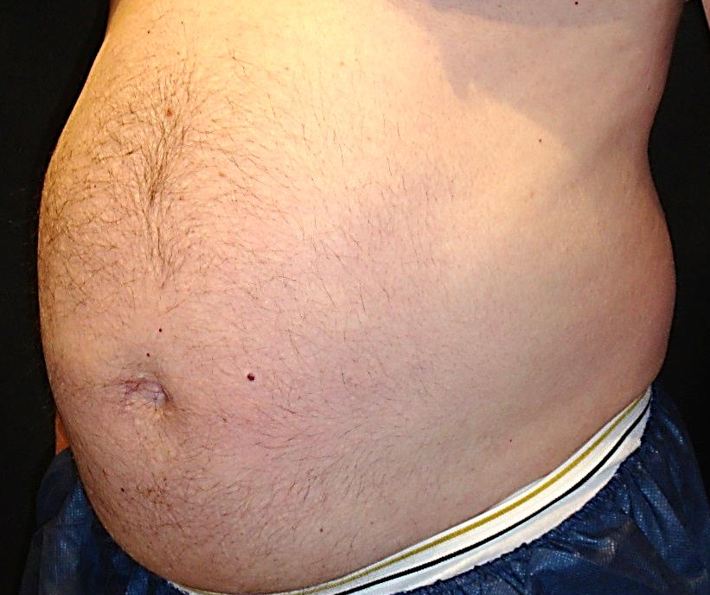
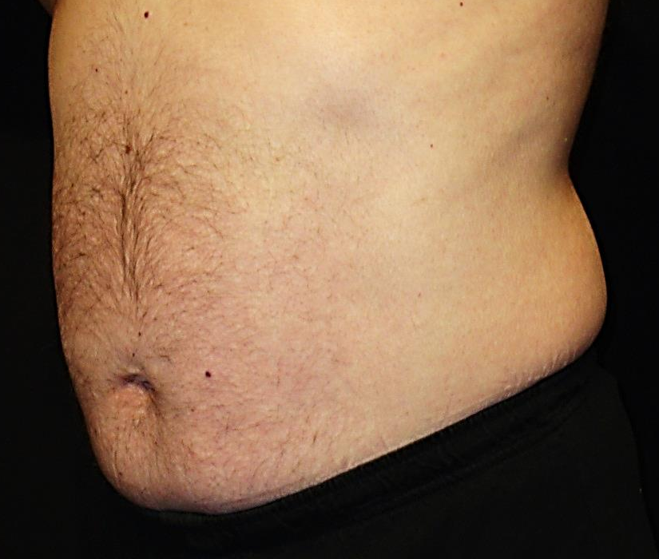
Age 32
Before
After
5.8.12
9.11.12
ABDOMEN / LOVE HANDLES
ONE TREATMENT ~ 4.5 MONTH RESULT Shiloh Medical Clinic ©
Notes:
Shelly Pierce

Slide 3
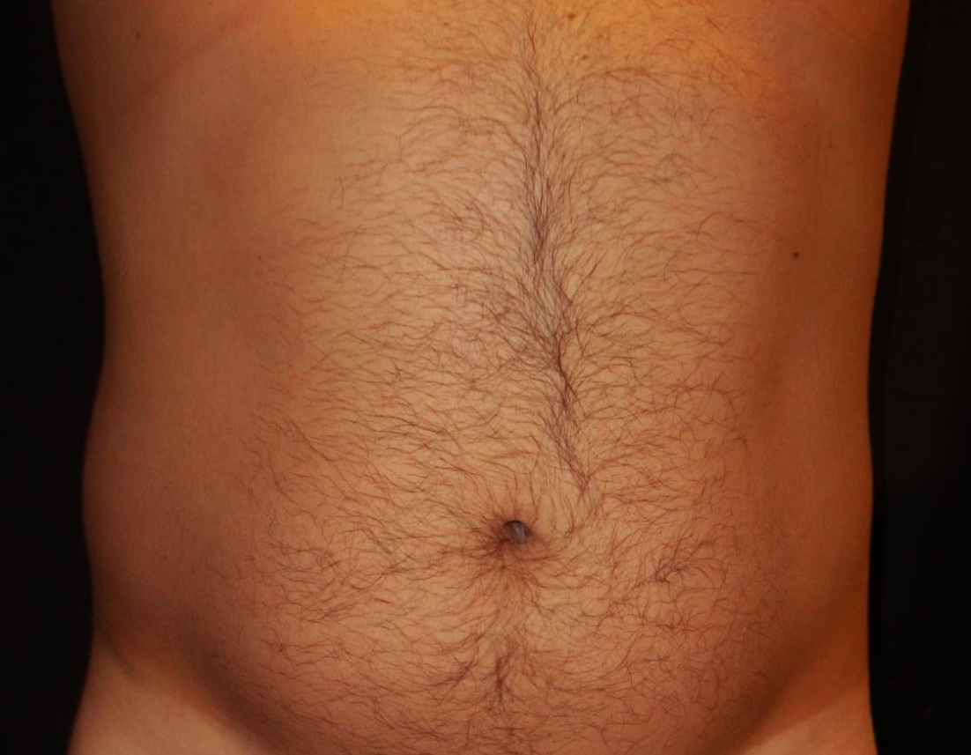
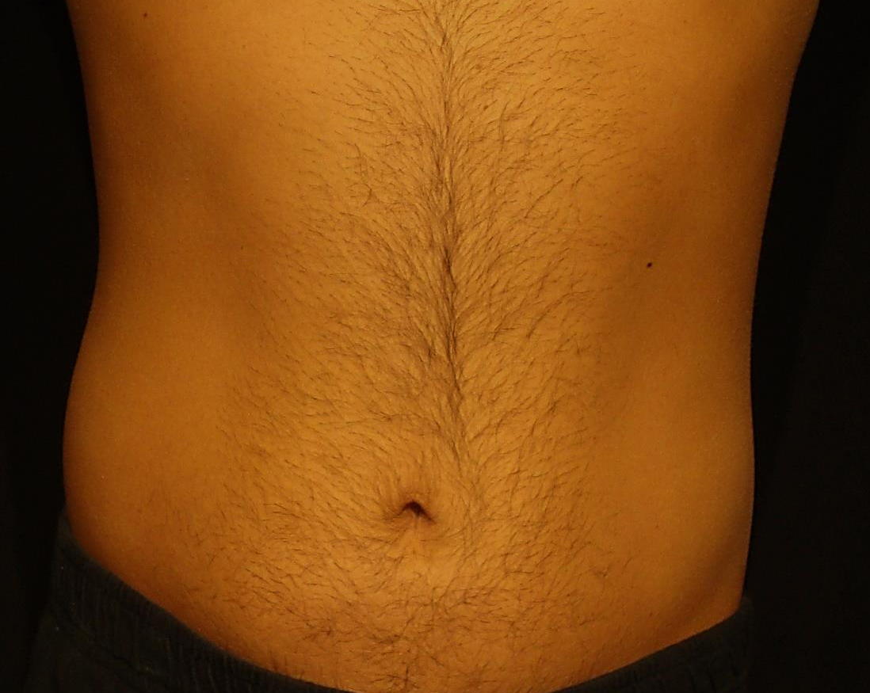
CoolSculpting® Lower Abdomen

